Slide 1
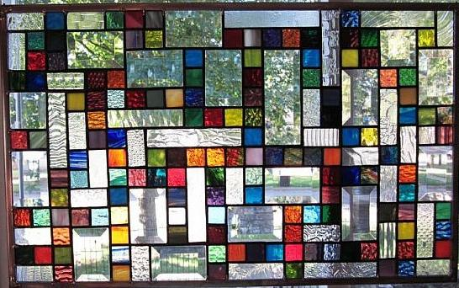
“Britto” Stained Glass Windows

Slide 2
Look for Similarities and Differences in the upcoming slides….

Slide 3
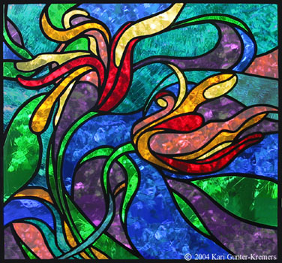

Slide 4
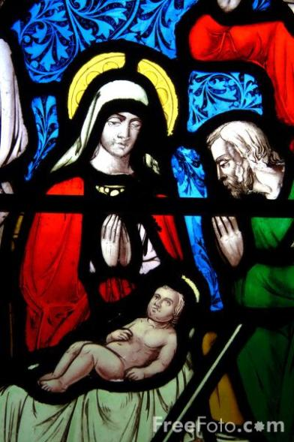
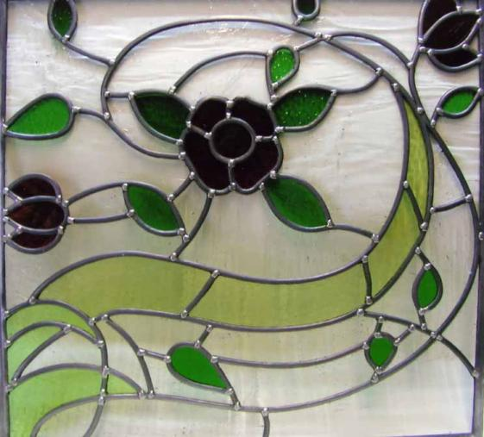

Slide 5

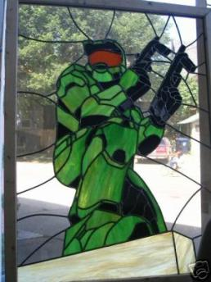
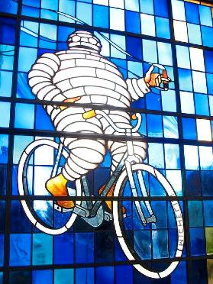
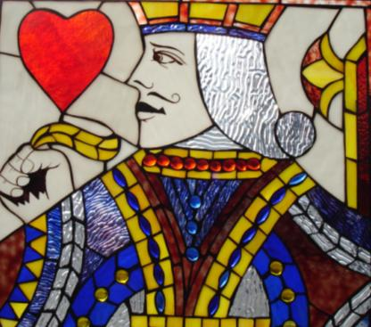

Slide 6
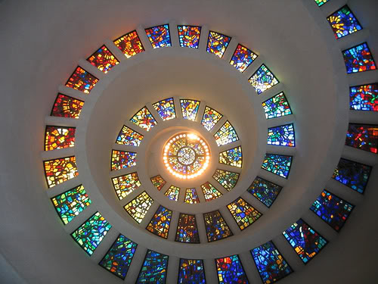

Slide 7


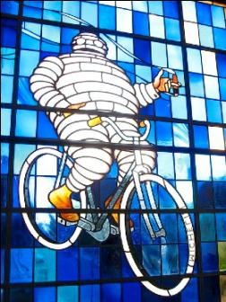


List the similarities
and differences

Slide 8
What are some
Common Characteristics?

Slide 9
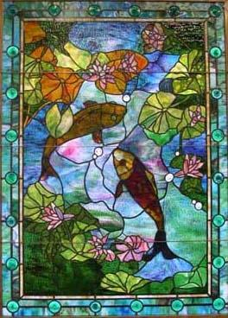
What is a Stained Glass Window?
Coloured glass is crafted into stained glass windows by arranging small pieces of glass to form patterns or pictures.

Slide 10
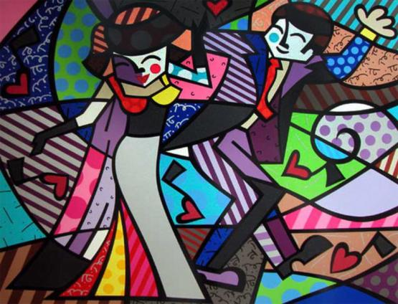
Romero Britto
1636 – present
Brazil

Slide 11
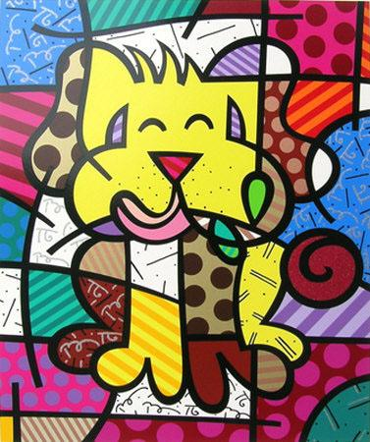
Britto uses the black lines just like stained glass.

Slide 12
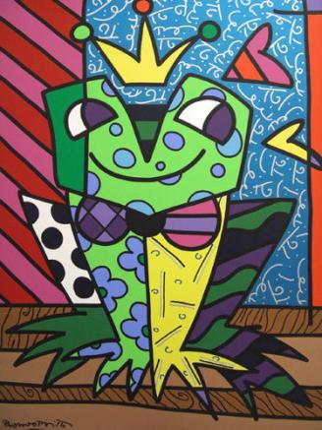
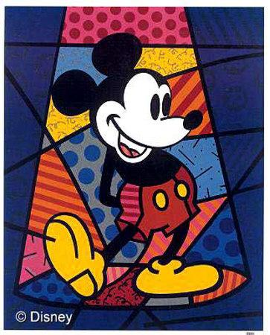
Sometimes the subject is in tact, other times it is broken up by some of the background lines.

Slide 13
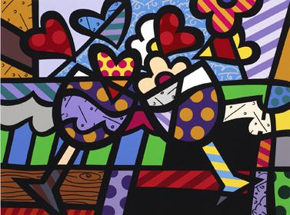
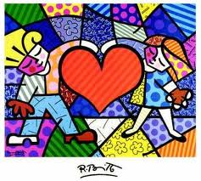
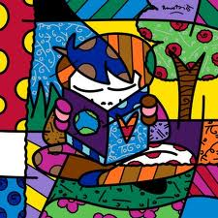
His work features bright Primary and
Secondary Colours

Slide 14
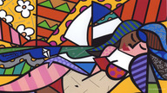
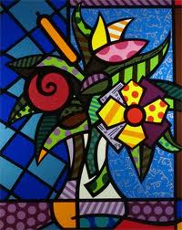
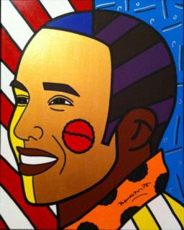

Slide 15
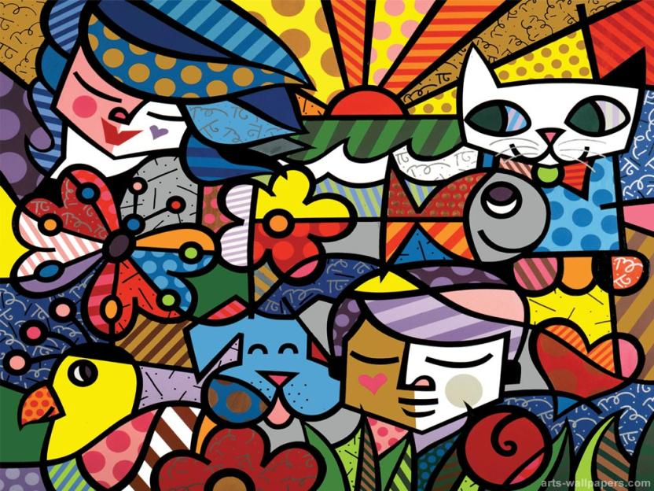

Slide 16
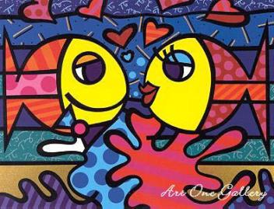
Step 1
Think about some themes/images you may like to use for your main image.
If you are having trouble thinking of an image – try thinking of a general category first
(eg Nature, Video Games or Pop Culture).
In this work the main images are fish.

Slide 17
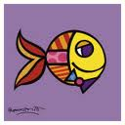
Images
Notice that Britto’s images are styalized?
  What does that mean?

Slide 18
Step 2
Practice drawing your main image.
If you sketch something you really like we can trace it onto your good copy paper.

Slide 19
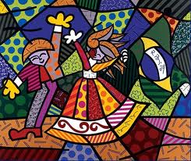
Step 3
Divide up the background. Using cues from your main image for
where to put lines.
In this picture, Britto
used the pleats in the
dress as one of his
lines.
  Where else did he do
  this?

Slide 20
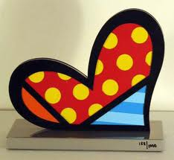
Step 4
Chose colours that really pop!
  Primary and secondary colours.

Slide 21
Step 5
Outline in black and let dry

Slide 22
Step 6
When dry, paint with oil – let dry for 3 days.

Slide 23
Assignment details
Objectives: Students will…
create artworks, integrating themes found through direct observation, personal experience, and imagination
analyze and use a variety of image development techniques (e.g. distortion, metamorphosis, fragmentation)
draw upon other arts disciplines as a resource in the creation of their own art works

Slide 24
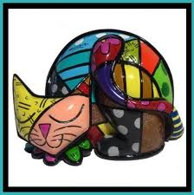
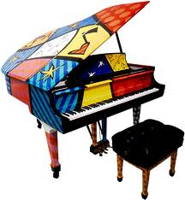

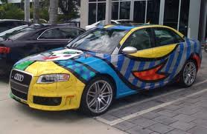
Other Britto Items

